Slide 1
VaccAttacc
A model proposition presented by Charles Pan’s Plan
Notes:
Greetings fellow humans, I am Charles Pan and I am here to introduce my non-profit human organization, VaccAttacc.
Our goal is to provide a human solution and reach out to other human organizations fight the inhumane H1N1 Flu and Seasonal Flu.

Slide 2

What is the Flu?
Notes:
What Is The Flu?

Slide 3

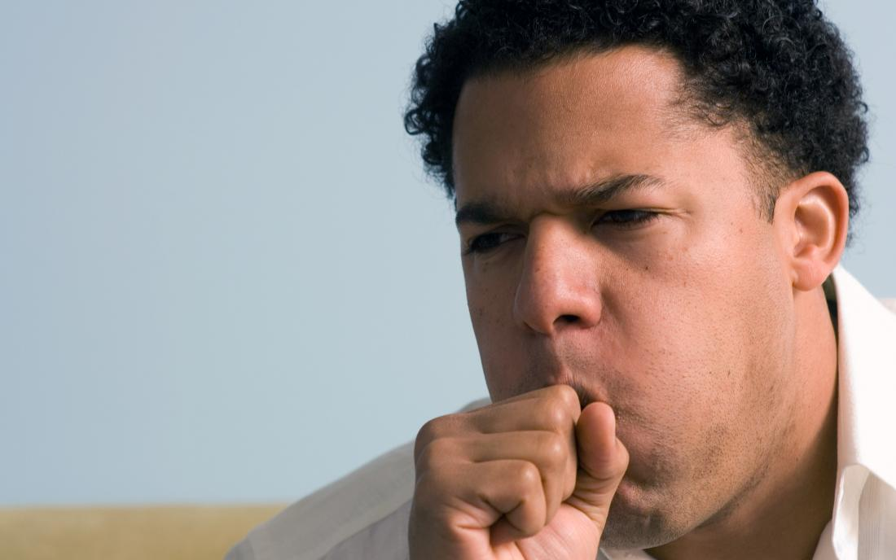
Seasonal Flu
Common during Fall and Winter Months.
Not the same as the common cold.
Notes:
The seasonal influenza aka flu is an acute respiratory infection.
The illness can lead to hospitalization, the seasonal flu tends to occur more common in the winter.

Slide 4
H1N1
Subtype of Influenza A Virus
Strains: Spanish Flu, 1977 Russian Flu, 2009 Swine Flu
Notes:
The H1N1’s most infamous strain is the Swine Flu which became prevalent in 2009.
In June 2009; the WHO declared the H1N1 Pandemic and in October 2009; Obama declared it a national emergency.
From 2009 to 2010 there were 60.8 Million cases, 274 thousand hospitalization and 12,469 confirmed deaths.

Slide 5
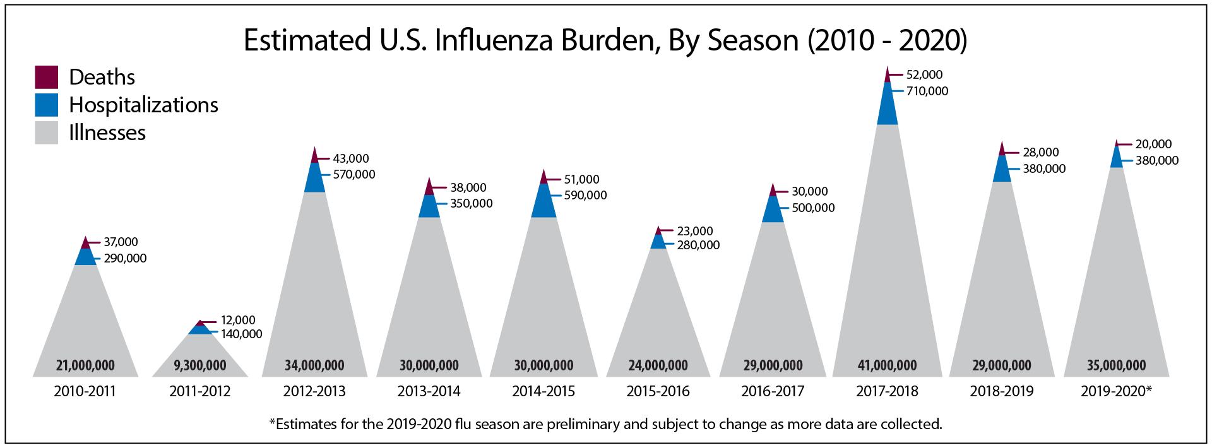
Source: CDC Website
Notes:
This illustrates how widespread the flu is, and how millions are impacted each year.
With twenty thousand deaths from 2019 to 2020, thousands could be prevented with the right outreach and prevention.

Slide 6
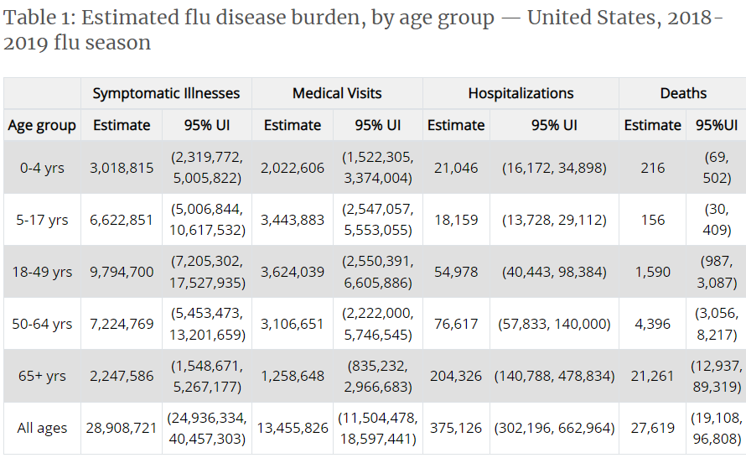
Source: CDC Website
Notes:
The following is a table from the CDC of the estimated flu disease burden by age, while young people are not high at risk; they are still spreaders.
Grandpa didn’t live for 70 years avoiding death only to be hit by a simple cough. If you haven’t been vaccinated, do it now. Do it for gramps.

Slide 7
So what is the purpose of VaccAttacc?
Notes:
Our group VaccAttac has come to offer a solution on dealing with the Flu; not by science or medicine, but rather by social outreach and spreading knowledge.

Slide 8
The Plot
Step 1:
Step 2:
Step 3.
Send questionnaires, and collect people’s opinions on things
Identify those who are potentially not vaccinated based off the questionnaire.
Reach out to those at risk and provide them where and why should get vaccinated for H1N1/Seasonal.
Notes:
Our first step is to send questionnaires or have them posted at medical offices to be filled out.
Afterwards, we collect those filled questionnaires and feed them into our predictive model to find those unvaccinated individuals
From there, we can hunt and bother those unvaccinated individuals and inform them of the dangers of the flu and inspire them to get vaccinated.

Slide 9
Our Questionnaire…
22 Questions - Simple Questions
Examples: H1N1 Concern [ 0 - 3 ]
Health Worker [ True / False ]
Age Group [ 18-34, 35-44, 45-54, 55-64, 65+ ]
Race [ White, Black, Hispanic, Other ]
Income Level [ Below Poverty, Above, 75k+ ]
Notes:
So for our question we will ask around 22 questions nothing too suspicious, with those questions being fed into our
predictive models which will predict whether that person has been H1N1 Vaccinated or Seasonal Flu Vaccinated.
You might be thinking, the H1N1 is no big deal nowadays; false! One should always stay vaccinated particularly to prevent becoming a super spreaders.

Slide 10
Our Predictive Models
The H1N1 Model The Seasonal Flu Model
Accuracy Rate: 83%
Recall Rate: 42%
Precision: 68%
Accuracy Rate: 77%
Recall Rate: 73%
Precision: 77%
Notes:
This is how our predictive model performed in terms of accuracy, recall, and precision score.
Accuracy score shows how accurate the model is in identifying the positive or negatives.
Our H1N1 model has a low recall rate which means that we’ll be reaching out to those that are predicted to be unvaccinated.
The Precision score shows us the correct positives out of all positives, and it’s better our precision is higher than our recall as that is our priority.

Slide 11



So What Now?
Notes:
If you would like to work with us, or know any organisations that would.
We would love to join up with you or your organisation and strategize on how to further outreach and educate the common public to get them informed and vaccinated.
Even if it’s just going to your doctor’s office and asking if you can distribute questionnaires or pamphlets at the front desk, any outreach is appreciated.

Slide 12
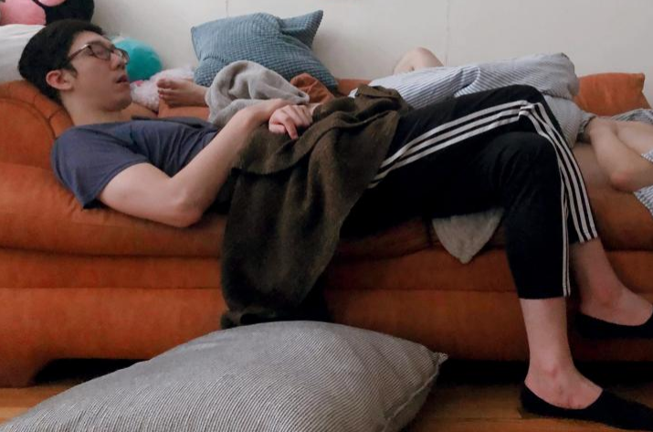
THANKS
Do you have any questions?
charlesmpan@gmail.com
www.linkedin.com/in/charles-pan-/
www.github.com/charlesmpan
Please keep this slide for attribution
Notes:
Thanks for coming to my presentation, any questions?

